Slide 1
OptNet: End-to-End Differentiable Constrained Optimization
Brandon Amos Carnegie Mellon University
Joint work with J. Zico Kolter, Priya Donti, Jacob Sacks, Ivan Jimenez Rodriguez, and Byron Boots

Slide 2
Where do today’s ML systems break down?
A lot of data
Model
Predictions
Loss
Current Primitive Operations: Linear maps, convolutions, activation functions, random sampling, simple projections (e.g. onto the simplex or Birkhoff polytope)
OptNet: Optimization as a new primitive operation
Consider optimization as another potential layer, to be composed with others
Why? Optimization is an extremely powerful paradigm for decision-making.
Applications in finance (Markowitz portfolio optimization), machine learning (support vector machines), control (linear-quadratic model predictive control), geometry (projections onto polyhedra)
Note: we already use parameter optimization in the learning procedures, but we should also consider it as an operation for inference and control
Notes:
+ In the ML community, we have a rich toolkit of primitive operations.
+ Where do these break down? Many ways to analyze
+ Trend lately: Showing how classical algorithms and operations can be made differentiable. I show how to do this for optimization
+ *Not* parameter optimization

Slide 3
Why is optimization a useful primitive operation in learning systems?
We have incomplete domain knowledge about what we want to model
Fill in parts of the optimization problem that we know
Use data to learn the parts that we don’t
A lot of data
Model
Predictions
Loss
(Learned) Abstract Representation
(Learned) Solver

Slide 4


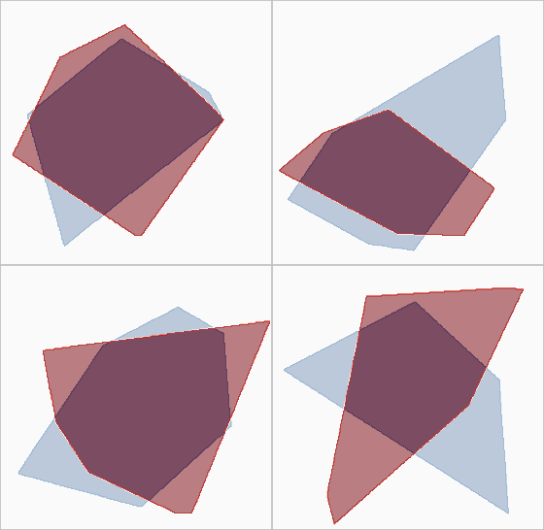
OptNet Application: Approximating Polytopes
True Polytope (Unknown to the model)
Polytope Predictions During Training
Example 1
Example 2
Example 3
Example 4

Slide 5
This Talk
The OptNet Layer
Starting Simple: Learning Projections, Sudoku, and Denoising
End-to-End Task-Based Learning for Stochastic Optimization
End-to-End Model Predictive Control

Slide 6
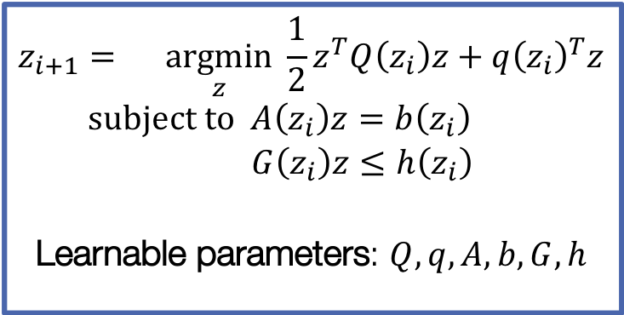
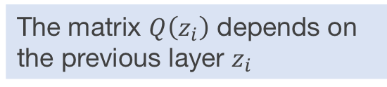
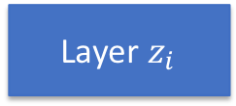
The OptNet Layer
A lot of data
Model
Predictions
Loss
…
Layer $z_{i}$
OptNet Layer
…
$$z_{i+1}=\underset{z}{argmin}{\frac{1}{2}z^{T}Q\left(z_{i}\right)z+q{\left(z_{i}\right)}^{T}z} \\ subject to A\left(z_{i}\right)z=b\left(z_{i}\right) \\ G\left(z_{i}\right)z≤h\left(z_{i}\right)$$
Learnable parameters: $Q,q,A,b,G,h$
The matrix $Q\left(z_{i}\right)$ depends on the previous layer $z_{i}$
Notes:
+ We could hard-code in values for the objective or constraints but we don't have to
+ Argmin gives well-defined output under some assumptions

Slide 7
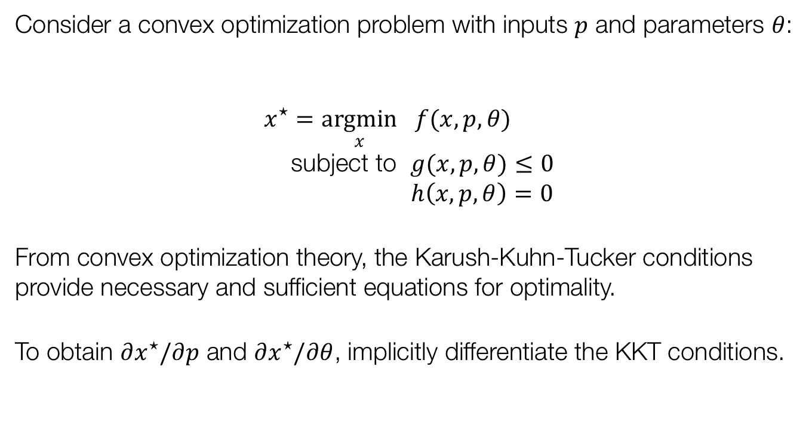
Differentiating a convex argmin
Consider a convex optimization problem with inputs $p$ and parameters $θ$:
$$x^{⋆}=\underset{x}{argmin}{ f(x, p,θ)} \\ \text{subject} \text{to} g(x, p, θ)≤0 \\ h\left(x, p, θ\right)=0$$
From convex optimization theory, the Karush-Kuhn-Tucker conditions provide necessary and sufficient equations for optimality.
To obtain $∂x^{⋆}/∂p$ and $∂x^{⋆}/∂θ$, implicitly differentiate the KKT conditions.

Slide 8
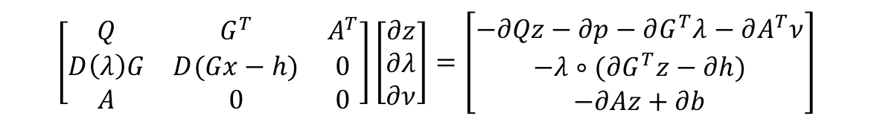
Implicitly differentiating the KKT conditions
Solve linear systems of the form:
If done correctly, just requires a single solve to compute all gradients
More details are in our OptNet paper (ICML 2017)
$$\left[\begin{matrix}Q & G^{T} & A^{T} \\ D\left(λ\right)G & D(Gx−h) & 0 \\ A & 0 & 0\end{matrix}\right]\left[\begin{aligned}∂z \\ ∂λ \\ ∂ν\end{aligned}\right]=\left[\begin{aligned}−∂Qz−∂p−∂G^{T}λ−∂A^{T}ν \\ −λ∘(∂G^{T}z−∂h) \\ −∂Az+∂b\end{aligned}\right]$$
Generalized Jacobian of KKT conditions
Desired gradients
Gradients of optimization problem parameters

Slide 9

Efficient implementation
Optimization in every single pass of the network, even using highly optimized (but necessarily still general purpose) solvers, is slow
Implemented our own primal-dual interior point algorithm for QPs, specialized for minibatch processing of multiple same-sized problems using batch GPU factorization, plus some additional tricks
Very nice property: matrix solution needed for backprop is exactly the same as that used in interior point final inner solve, meaning we get backprop through the solver effectively “for free”
Open source implementation (for PyTorch) available at: http://locuslab.github.io/qpth

Slide 10
This Talk
The OptNet Layer
Starting Simple: Learning Projections, Sudoku, and Denoising
End-to-End Task-Based Learning for Stochastic Optimization
End-to-End Model Predictive Control

Slide 11
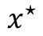
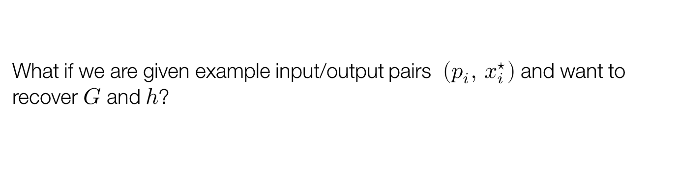
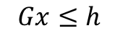
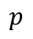
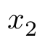
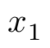
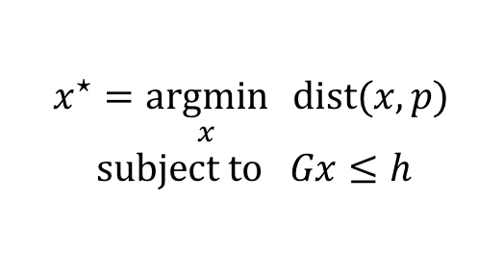
Projection as a machine learning problem
$$x_{2}$$
$$p$$
$$x^{⋆}$$
$$x^{⋆}=\underset{x}{argmin}{ \text{dist}(x, p)} \\ \text{subject} \text{to} Gx≤h$$
True Problem
$$Gx≤h$$
$$x_{1}$$
What if we are given example input/output pairs $\left(p_{i}, { x}_{i}^{⋆}\right)$ and want to recover $G$ and $h$?
Notes:
If you’re not familiar with loss functions, think of it as…

Slide 12
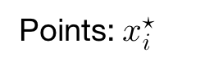
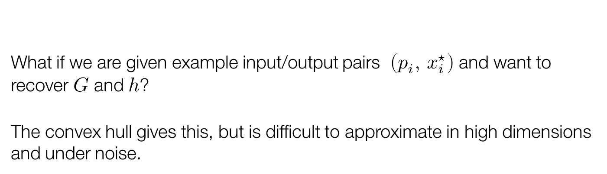
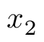
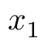
One Approach: Projection with a convex hull
$$x_{2}$$
Points: $x_{i}^{⋆}$
$$x^{⋆}=\underset{x}{argmin}{ \text{dist}(x, p)} \\ \text{subject} \text{to} Gx≤h$$
True Problem
$$Gx≤h$$
$$x_{1}$$
What if we are given example input/output pairs $\left(p_{i}, { x}_{i}^{⋆}\right)$ and want to recover $G$ and $h$?
The convex hull gives this, but is difficult to approximate in high dimensions and under noise.

Slide 13
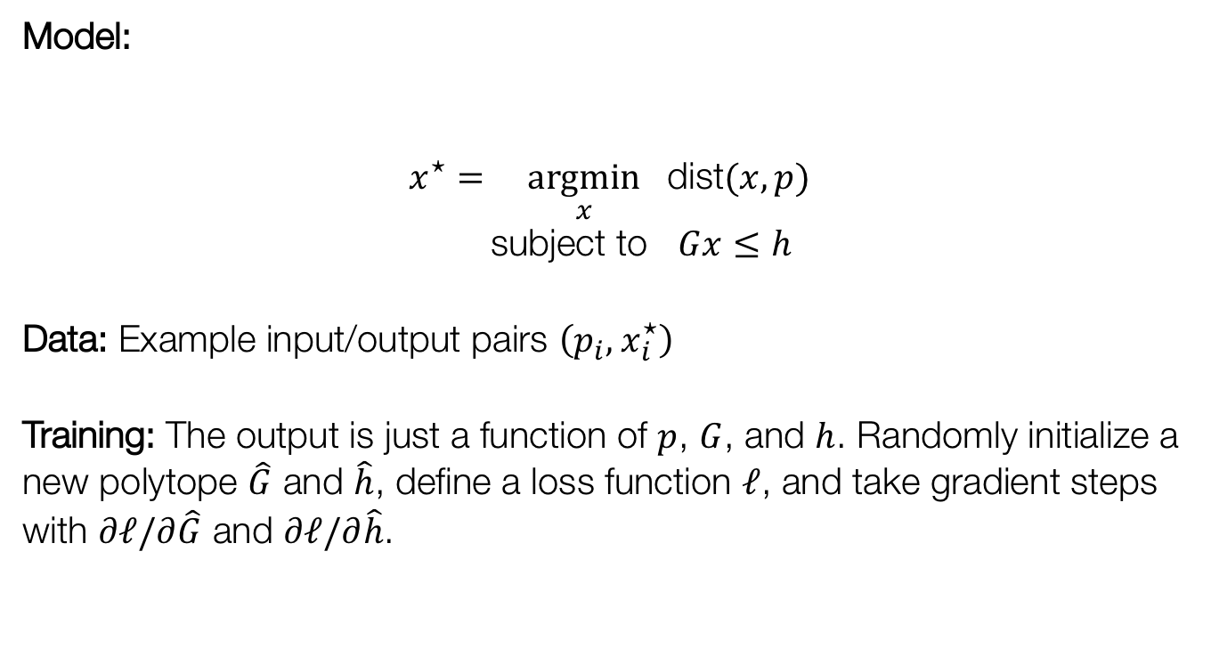
The OptNet approach to learning projections
Model:
$$x^{⋆}=\underset{x}{argmin}{ \text{dist}(x, p)} \\ \text{subject} \text{to} Gx≤h$$
Data: Example input/output pairs $\left(p_{i}, { x}_{i}^{⋆}\right)$
Training: The output is just a function of $p$, $G$, and $h$. Randomly initialize a new polytope $\hat{G}$ and $\hat{h}$, define a loss function $ℓ$, and take gradient steps with $∂ℓ/∂\hat{G}$ and $∂ℓ/∂\hat{h}$.

Slide 14
OptNet Application: Approximating Polytopes
True Polytope (Unknown to the model)
Polytope Predictions During Training
Example 1
Example 2
Example 3
Example 4

Slide 15
Application: Sudoku
Notes:
Actually integer programming

Slide 16
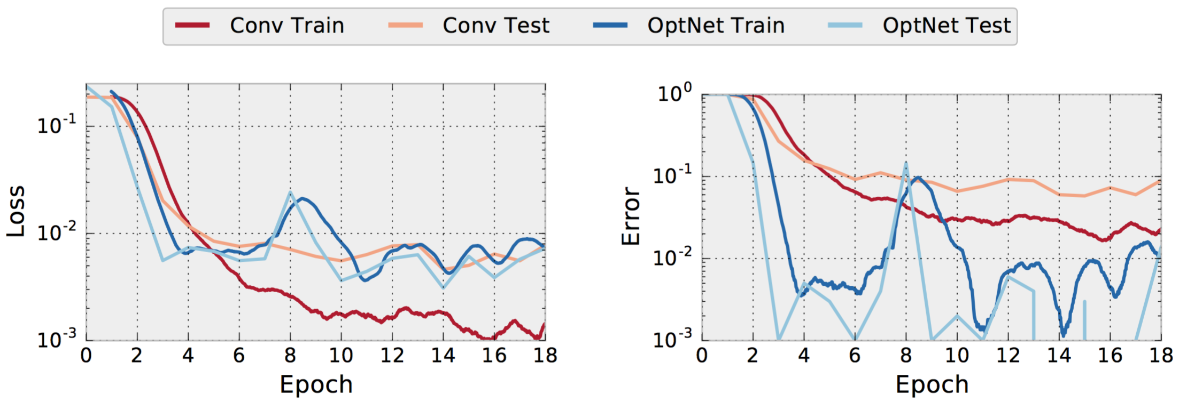
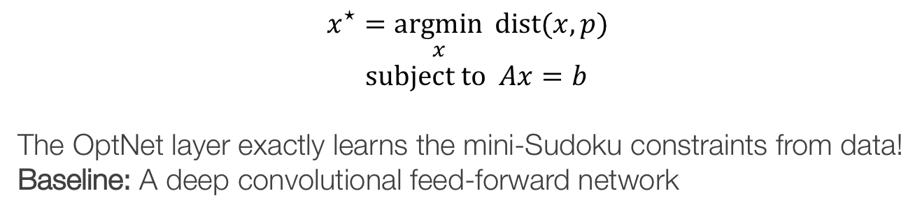
Application: Sudoku
$$x^{⋆}=\underset{x}{argmin}{ \text{dist}(x, p)} \\ \text{subject} \text{to} Ax=b$$
The OptNet layer exactly learns the mini-Sudoku constraints from data!
Baseline: A deep convolutional feed-forward network
% Incorrectly Solved Boards
Notes:
+ Neural nets: Learns in a soft way, not exact

Slide 17
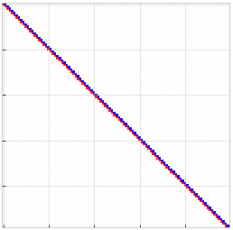
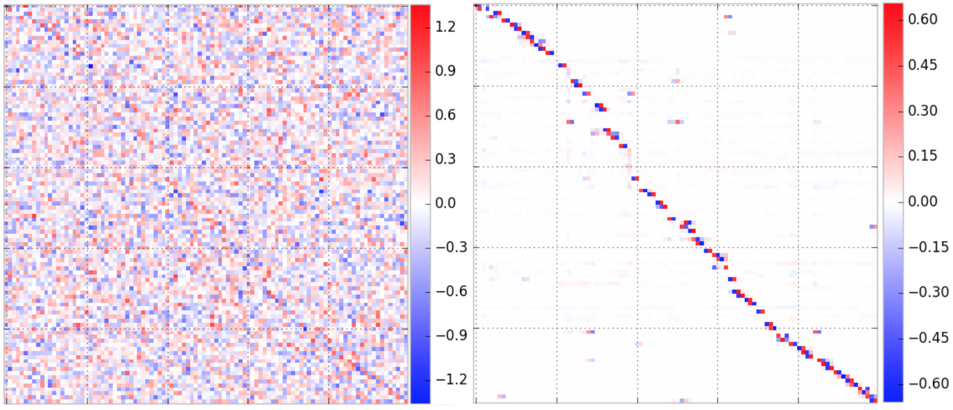
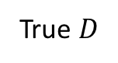
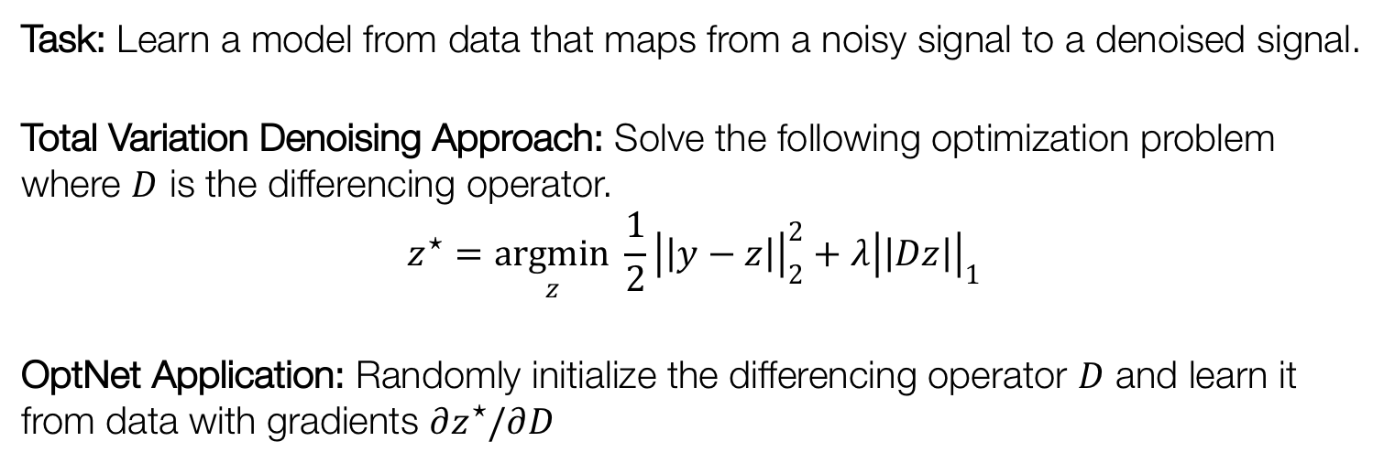
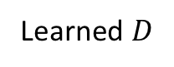
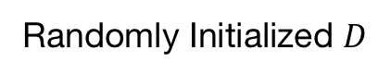
Application: 1D Signal Denoising
Task: Learn a model from data that maps from a noisy signal to a denoised signal.
Total Variation Denoising Approach: Solve the following optimization problem where $D$ is the differencing operator.
$$z^{⋆}=\underset{z}{argmin}{\frac{1}{2}{\left|\left|y−z\right|\right|}_{2}^{2}+λ{\left|\left|Dz\right|\right|}_{1}}$$
OptNet Application: Randomly initialize the differencing operator $D$ and learn it from data with gradients $∂z^{⋆}/∂D$
True $D$
Randomly Initialized $D$
Learned $D$
Notes:
Clarify problem setup
Show true D operator

Slide 18
This Talk
The OptNet Layer
Starting Simple: Learning Projections, Sudoku, and Denoising
End-to-End Task-Based Learning for Stochastic Optimization
End-to-End Model Predictive Control

Slide 19
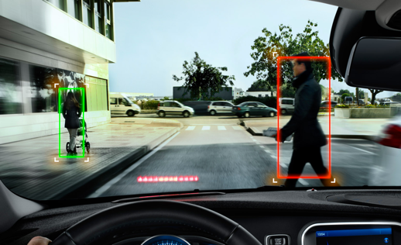
The future of machine learning
Data
Machine learning algorithm
Decision making
Cost, e.g. $$

Slide 20



Example: electricity generation
Generation schedule
$$≡z$$
Past demand
$$≡x$$
Future demand (w/ uncertainty)
Present
$$≡y$$

Slide 21
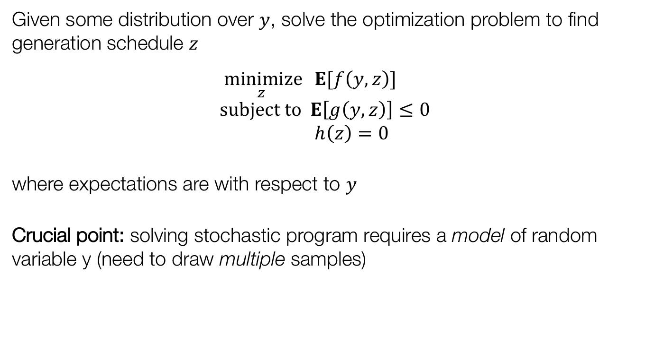
Stochastic programming
Given some distribution over $y$, solve the optimization problem to find generation schedule $z$
$$\underset{z}{minimize}{ E[f\left(y,z\right)]} \\ subject to E\left[g\left(y,z\right)\right]≤0 \\ h\left(z\right)=0$$
where expectations are with respect to $y$
Crucial point: solving stochastic program requires a model of random variable y (need to draw multiple samples)
I.e., “schedule generation to minimize expected cost under distribution”

Slide 22
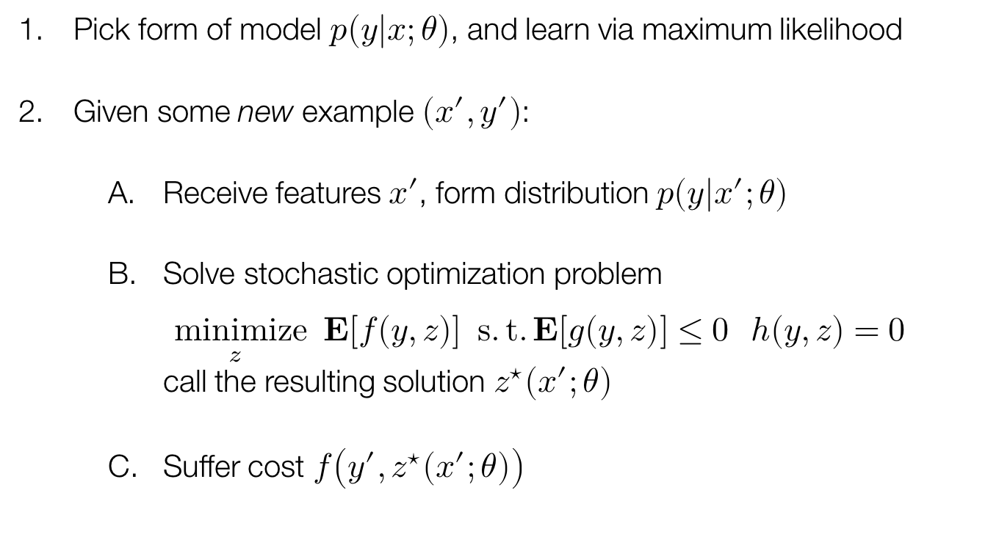
The whole (complicated) process
Pick form of model $p\left(y | x;θ\right)$, and learn via maximum likelihood
Given some new example $(x^{′},y^{′})$:
Receive features $x′$, form distribution $p(y|x^{′};θ)$
Solve stochastic optimization problem $\underset{z}{minimize}{ E[f\left(y,z\right)]} s.t. E[g\left(y,z\right)]≤0 h\left(y,z\right)=0$ call the resulting solution $z^{⋆}\left(x^{′};θ\right)$
Suffer cost $f\left(y^{′},z^{⋆}\left(x^{′};θ\right)\right)$
E.g., previous and future (actual) demand

Slide 23
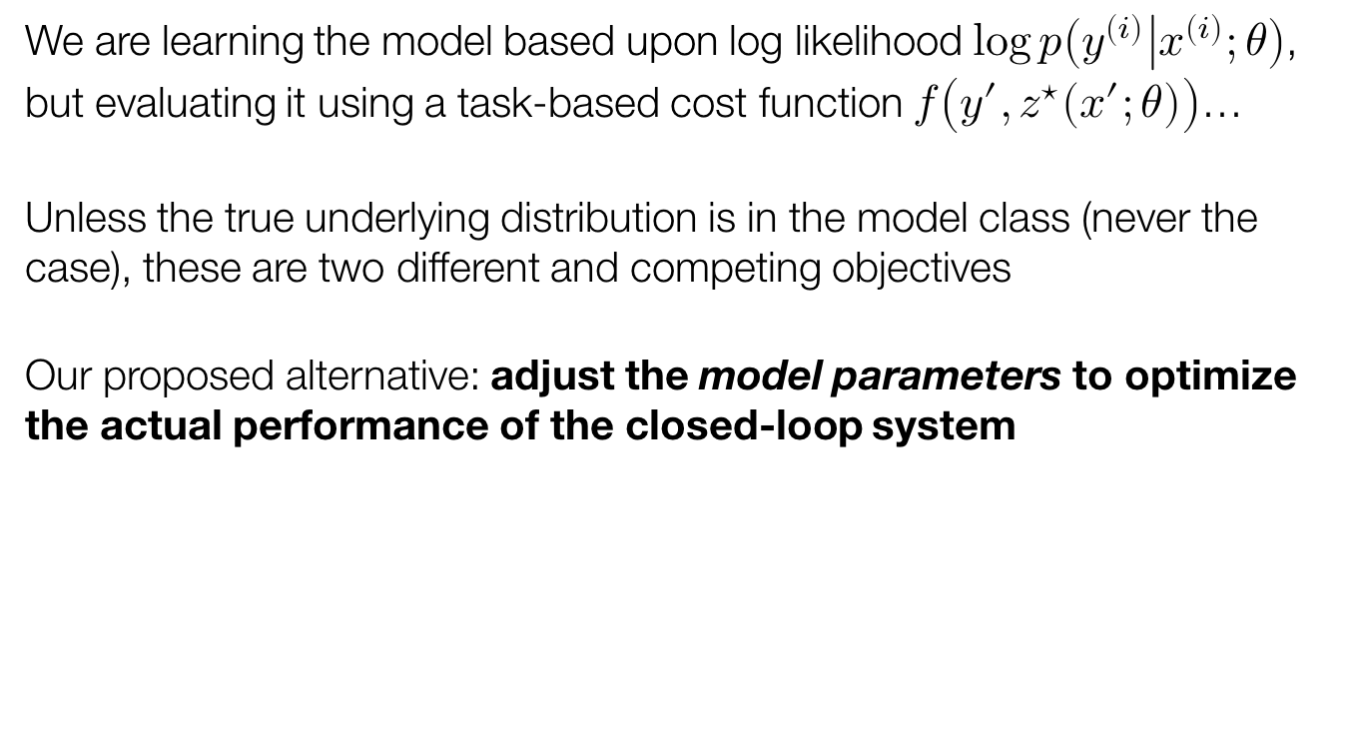
Something is wrong here…
We are learning the model based upon log likelihood $\log{p\left(y^{\left(i\right)} | x^{\left(i\right)};θ\right)}$, but evaluating it using a task-based cost function $f\left(y^{′},z^{⋆}\left(x^{′};θ\right)\right)$…
Unless the true underlying distribution is in the model class (never the case), these are two different and competing objectives
Our proposed alternative: adjust the model parameters to optimize the actual performance of the closed-loop system

Slide 24
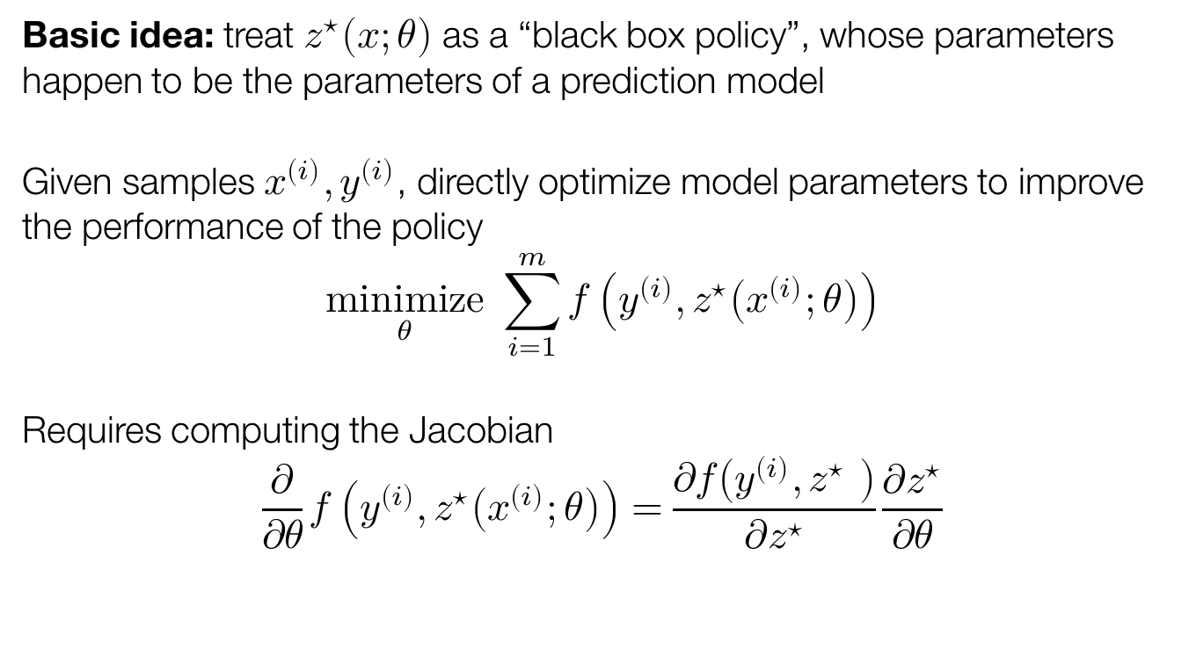
Task-based end-to-end model learning
Basic idea: treat $z^{⋆}\left(x;θ\right)$ as a “black box policy”, whose parameters happen to be the parameters of a prediction model
Given samples $x^{\left(i\right)},y^{\left(i\right)}$, directly optimize model parameters to improve the performance of the policy
$$\underset{θ}{minimize}{ \sum_{i=1}^{m}{f\left(y^{\left(i\right)},z^{⋆}\left(x^{\left(i\right)};θ\right)\right)}}$$
Requires computing the Jacobian
$$\frac{∂}{∂θ}f\left(y^{\left(i\right)},z^{⋆}\left(x^{\left(i\right)};θ\right)\right)=\frac{∂f\left(y^{\left(i\right)},z^{⋆} \right)}{∂z^{⋆}}\frac{∂z^{⋆}}{∂θ}$$
The Jacobian of the solution to the optimization problem

Slide 25

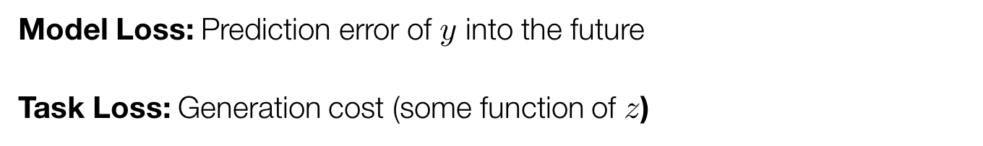

Task-based learning application: electricity generation
Generation schedule
$$≡z$$
Past demand
$$≡x$$
Future demand (w/ uncertainty)
Present
$$≡y$$
Model Loss: Prediction error of $y$ into the future
Task Loss: Generation cost (some function of $z$)

Slide 26

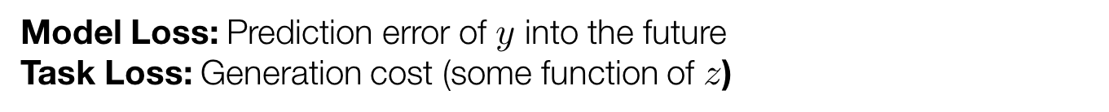
Results: electricity generation
The task net incurs nearly the same model loss as the baseline, but learns to make errors in places that aren’t as harmful to the task loss.
Model Loss: Prediction error of $y$ into the future
Task Loss: Generation cost (some function of $z$)
Model Loss

Slide 27
This Talk
The OptNet Layer
Starting Simple: Learning Projections, Sudoku, and Denoising
End-to-End Task-Based Learning for Stochastic Optimization
End-to-End Model Predictive Control

Slide 28
In model-based RL
Controller
Environment
Reward
Trajectories

Slide 29
Related work on combining model-based and model-free RL
Recently there has been a lot of interest in model-based priors for model-free reinforcement learning:
Among others: Dyna-Q (Sutton, 1990), GPS (Levine and Koltun, 2013), Imagination-Augmented Agents (Weber et al., 2017), Value Iteration Networks (Tamar et al., 2016), TreeQN (Farquhar et al., 2017)
These typically involve:
Using an RNN: Efficient but not as expressive and general as control
Unrolling an LQR solver: Expressive/general but inefficient

Slide 30
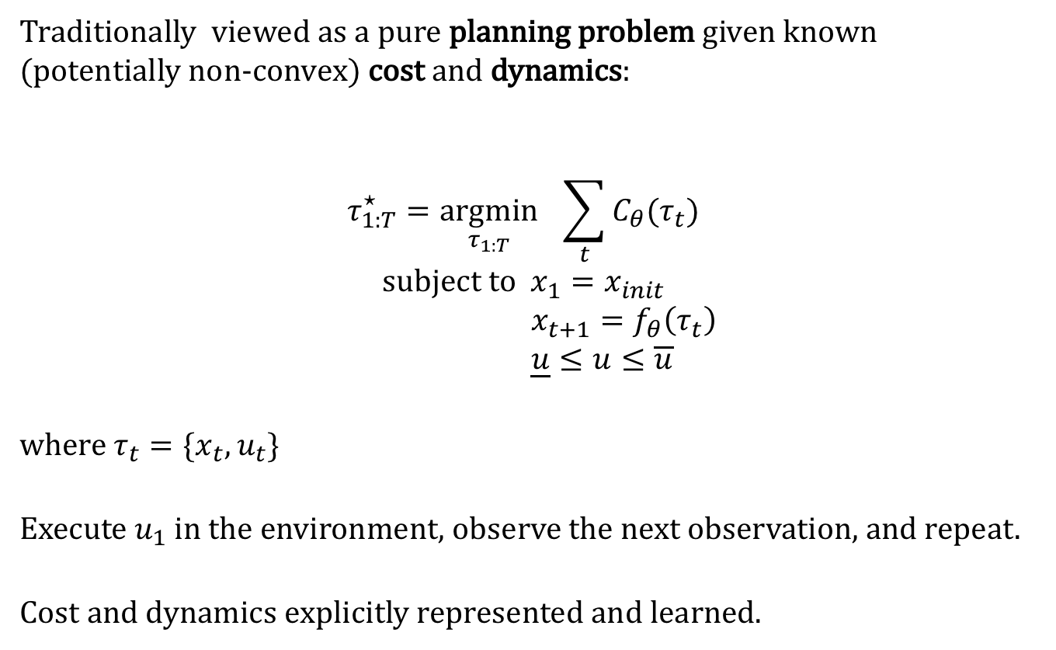
Our Approach: Model Predictive Control
Traditionally viewed as a pure planning problem given known (potentially non-convex) cost and dynamics:
$$τ_{1:T}^{⋆}=\underset{τ_{1:T}}{argmin}{ \sum_{t}{C_{θ}(τ_{t})}} \\ \text{subject} \text{to} x_{1}=x_{init} \\ x_{t+1}=f_{θ}\left(τ_{t}\right) \\ \underline{u}≤u≤\overline{u}$$
where $τ_{t}=\{x_{t}, u_{t}\}$
Execute $u_{1}$ in the environment, observe the next observation, and repeat.
Cost and dynamics explicitly represented and learned.
Cost
Dynamics

Slide 31
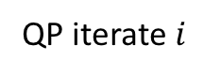
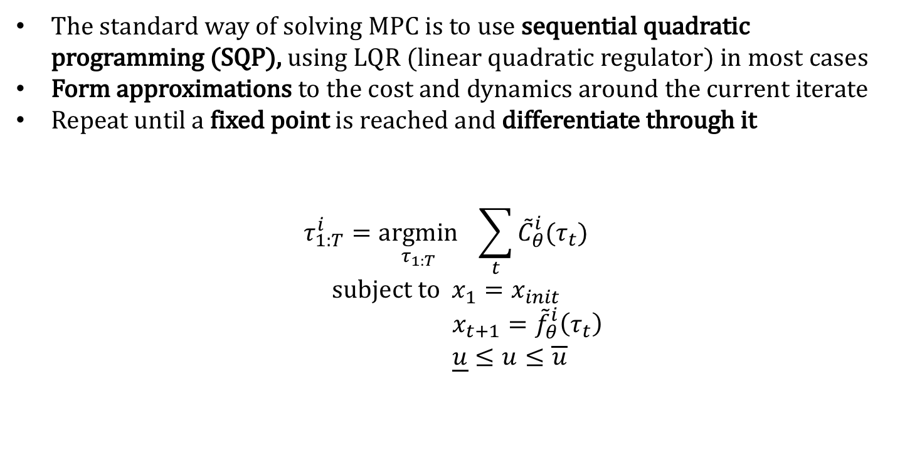
Model Predictive Control with SQP
The standard way of solving MPC is to use sequential quadratic programming (SQP), using LQR (linear quadratic regulator) in most cases
Form approximations to the cost and dynamics around the current iterate
Repeat until a fixed point is reached and differentiate through it
$$τ_{1:T}^{i}=\underset{τ_{1:T}}{argmin}{ \sum_{t}{{\tilde{C}}_{θ}^{i}(τ_{t})}} \\ \text{subject} \text{to} x_{1}=x_{init} \\ x_{t+1}={\tilde{f}}_{θ}^{i}\left(τ_{t}\right) \\ \underline{u}≤u≤\overline{u}$$
QP iterate $i$
...
...

Slide 32
A Differentiable MPC Module
Solve MPC with SQP, differentiate through the fixed point with OptNet
What can we do with this now?
Replace neural network policies in model-free algorithms with MPC policies, and also replace the unrolled controllers in other settings (hindsight plan, universal planning networks)
The cost can also be learned! No longer have to hard-code in a known value.

Slide 33
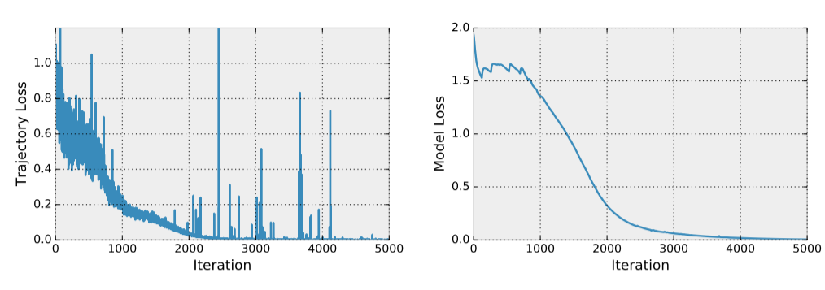
Imitation learning with a linear model
Notes:
Linear dynamics: $f\left(x_{t}, u_{t}\right)=Ax_{t}+Bu_{t}$
Parameters: $θ=\{A, B\}$
Trajectory: $τ_{θ}\left(x_{\text{init}}\right)$ obtained by MPC
Given known $θ$ and sample trajectories, learn $\hat{θ}$
Trajectory (Training) Loss: $\text{MSE}(τ_{θ}\left(x_{\text{init}}\right), τ_{\hat{θ}}\left(x_{\text{init}}\right))$
Model Loss: $\text{MSE}(θ, \hat{θ})$
Not guaranteed to converge, but a good sanity check that it does in small cases.

Slide 34
Some closing thoughts
(Exact) optimization is a powerful primitive to use within larger, interconnected systems
Such solvers can be propagated through and learned, just like any layer
Many applications of the technique
The general possibility of training complex end-to-end decision making systems is just getting started…

Slide 35


OptNet: End-to-End Differentiable Optimization
Brandon Amos | Carnegie Mellon University
Applications: Projections, Sudoku, Denoising, Task-based Learning, Model Predictive Control
OptNet: Differentiable Optimization as a Layer in Neural Networks B. Amos and J. Z. Kolter ICML 2017
Task-based End-to-end Model Learning P. Donti, B. Amos, and J. Z. Kolter NIPS 2017
https://locuslab.github.io/qpth/ https://github.com/locuslab/optnet https://github.com/locuslab/e2e-model-learning

